Slide 1
Hostel Management system
Cs258 group project -G3

Slide 2
About the Project
Overview
A web portal to manage Hostel
Project objective
Home Page, Registration, Login
Gallery
Complaints/Suggestions
Booking Rooms
Separate access for Warden, Staff and Students
Show profile and History of students
Manage Rooms and Complaints/Suggestions and pay bills

Slide 3
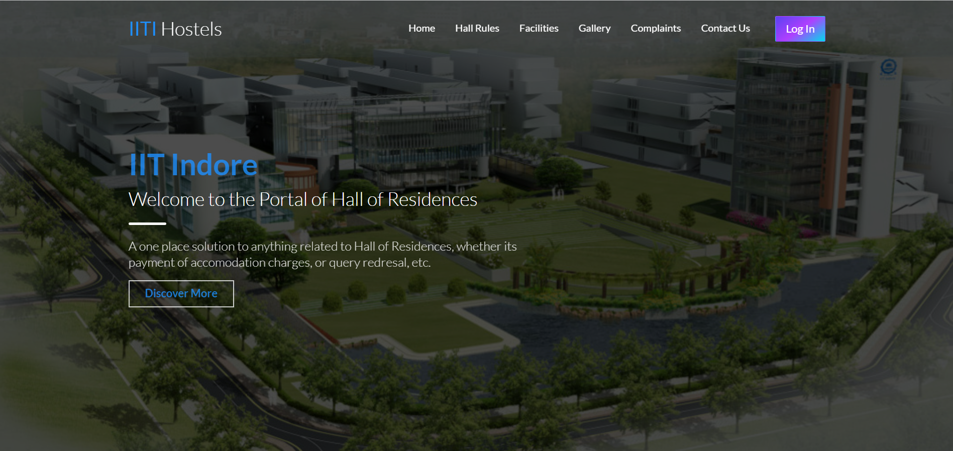
Application page

Slide 4
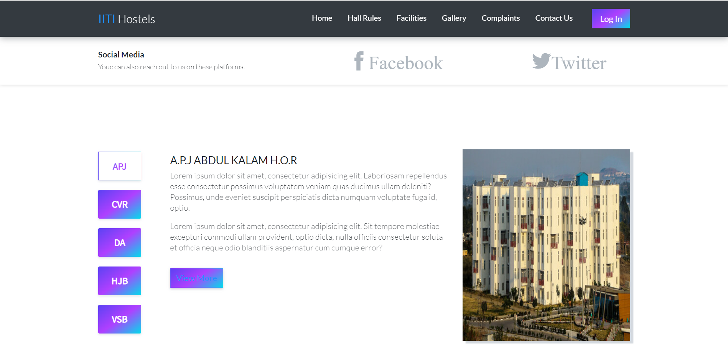
Hostel View

Slide 5
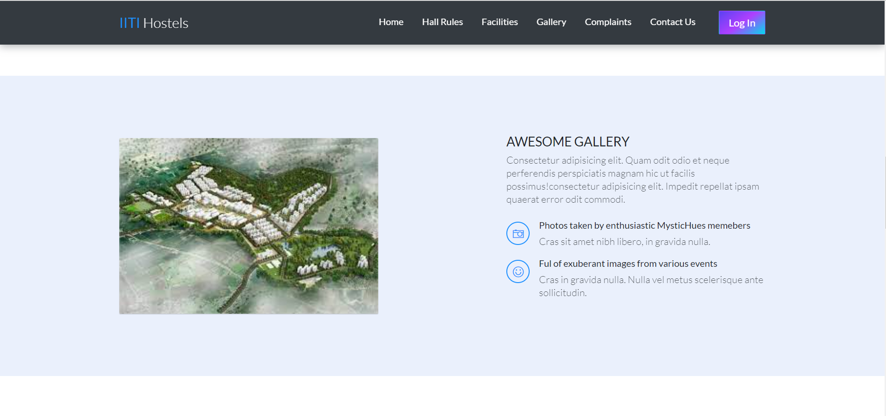
Gallery Description

Slide 6
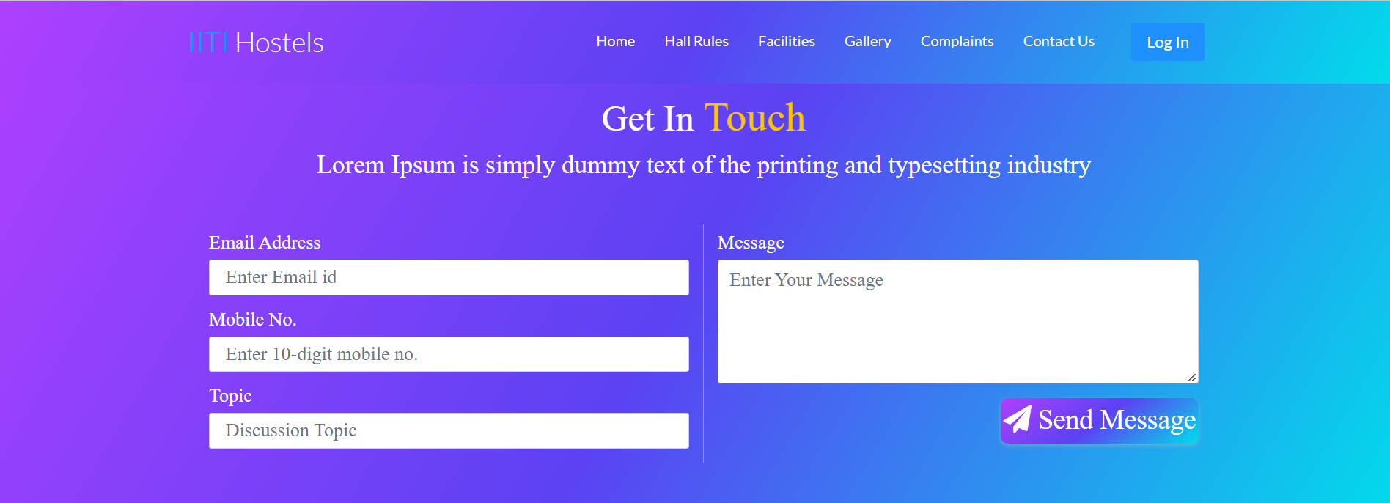
Contact Us Page

Slide 7
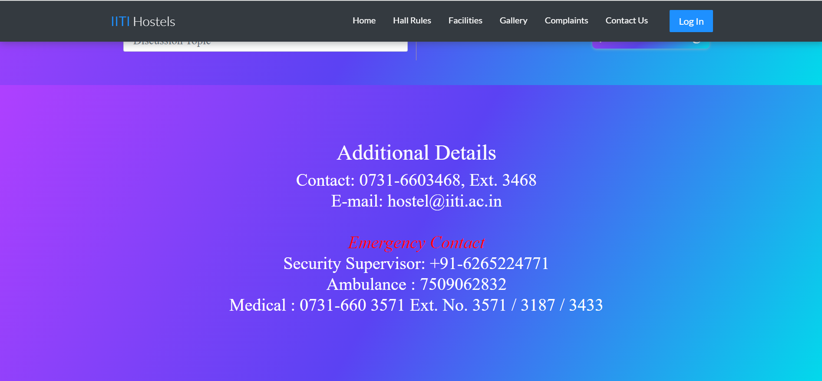
Contact Details

Slide 8
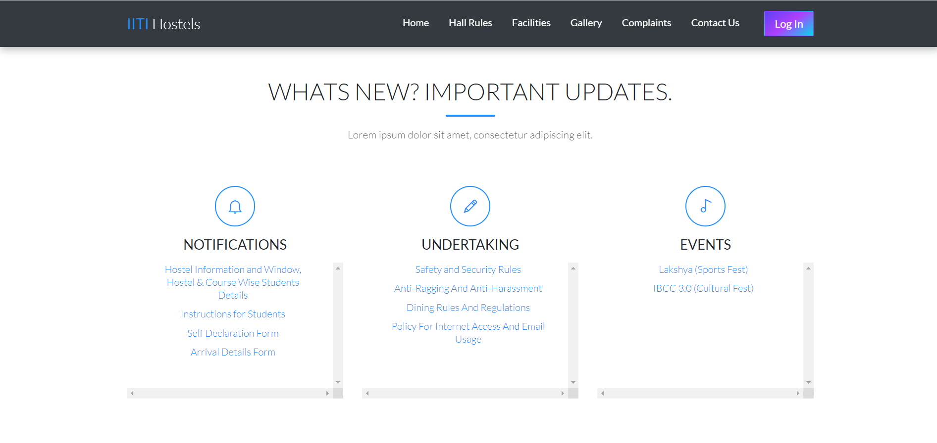
Notification Preview

Slide 9
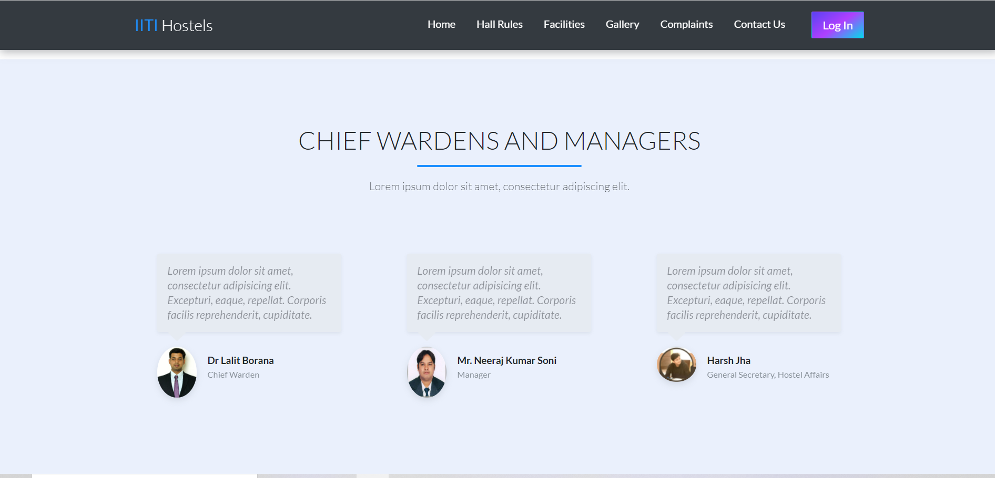
Admin Details

Slide 10
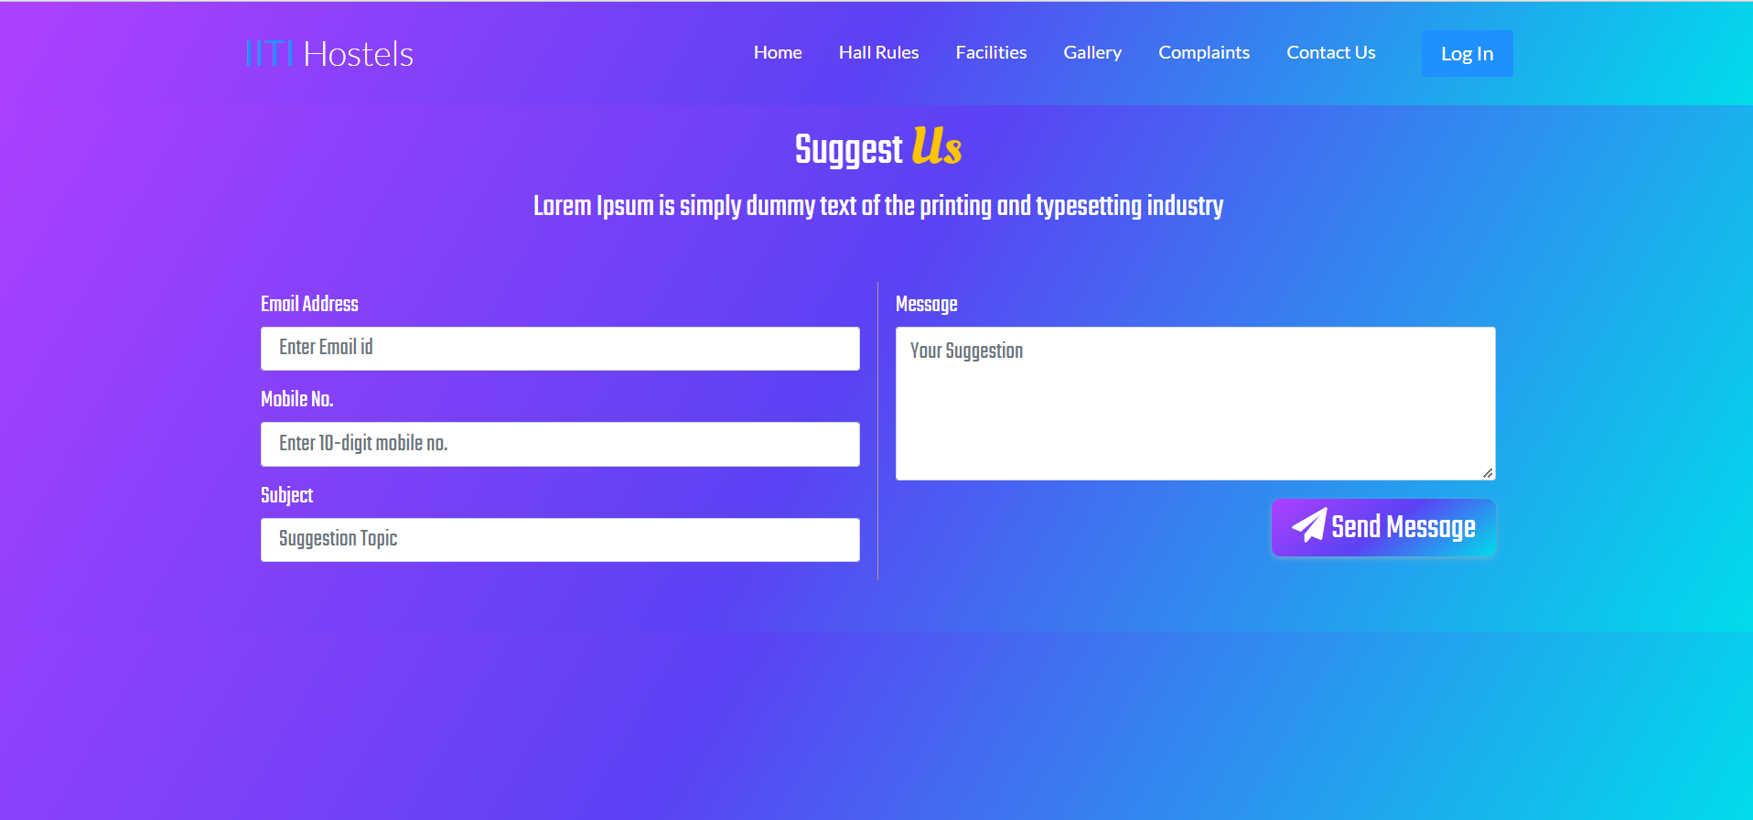
Give Suggestions

Slide 11
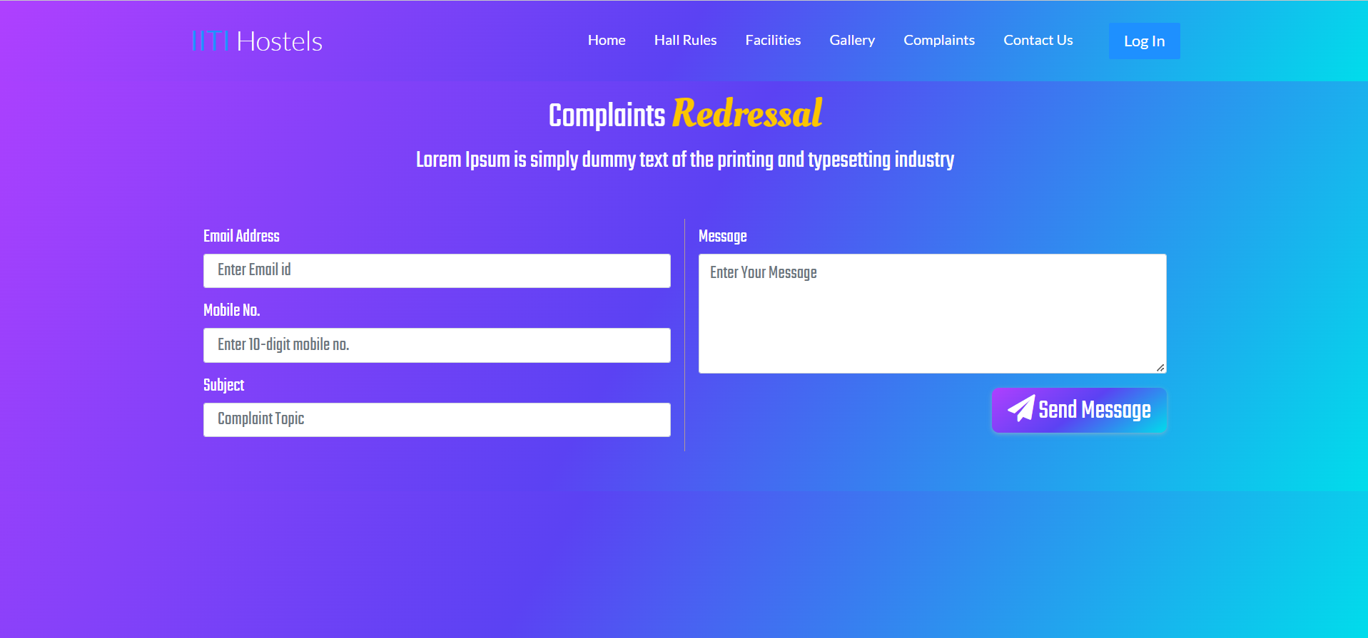
Complsints

Slide 12
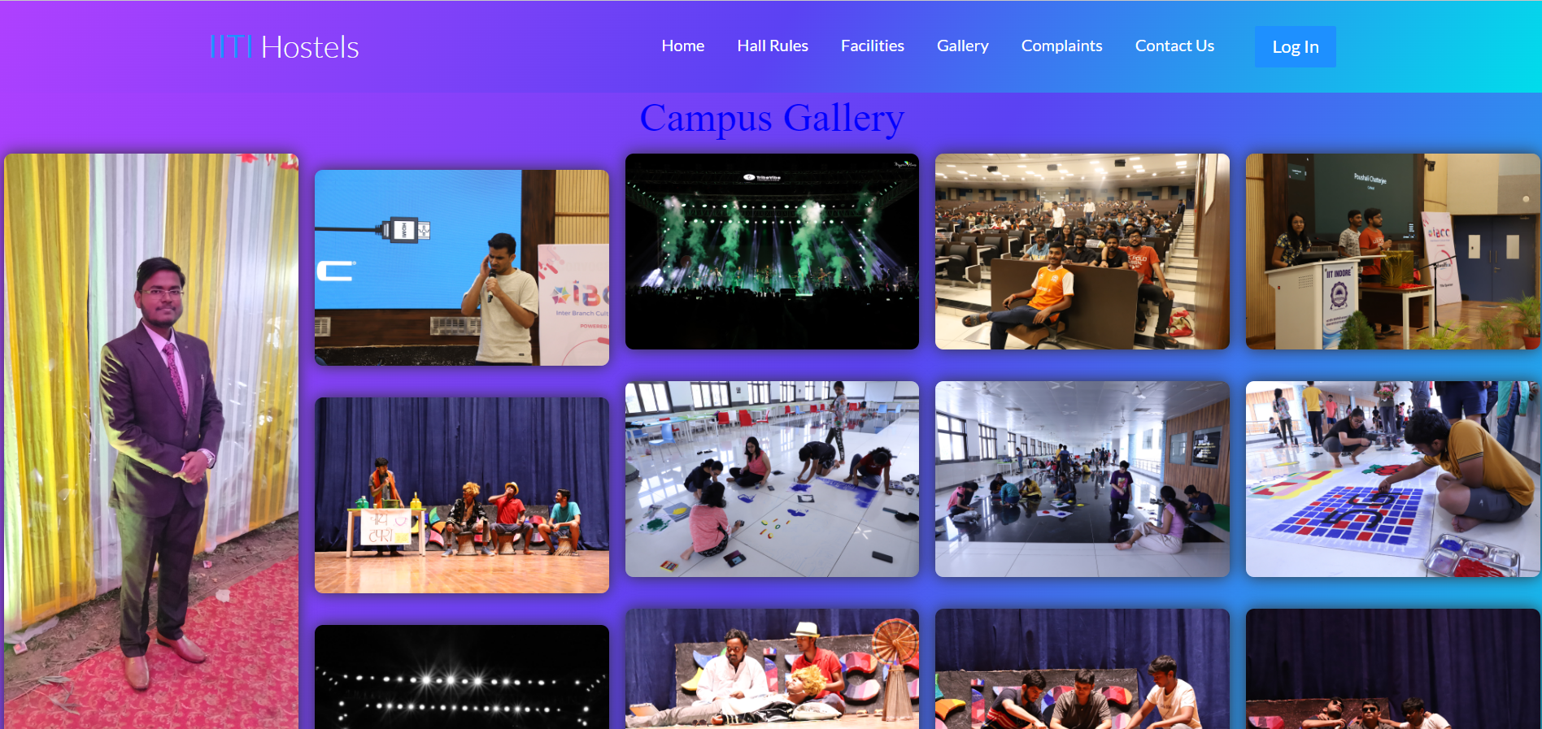
Gallery

Slide 13
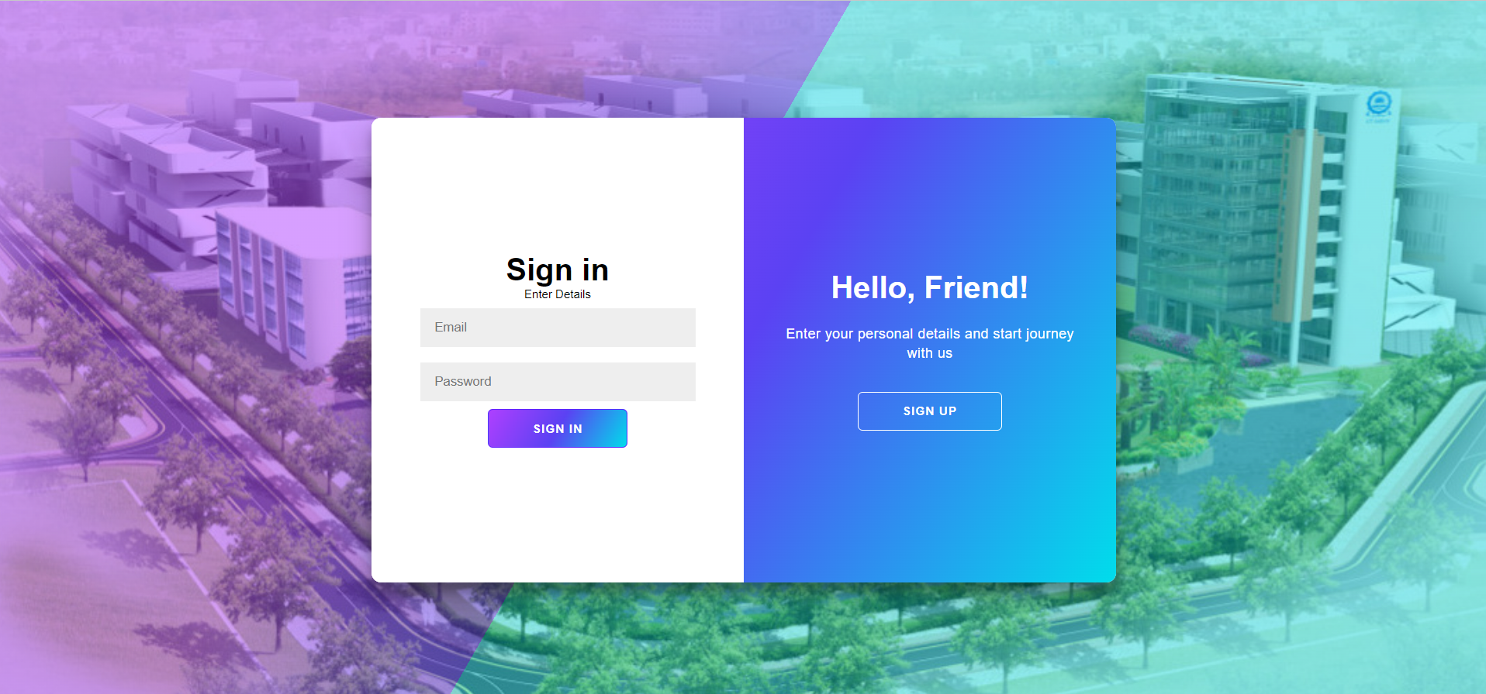
Sign In

Slide 14
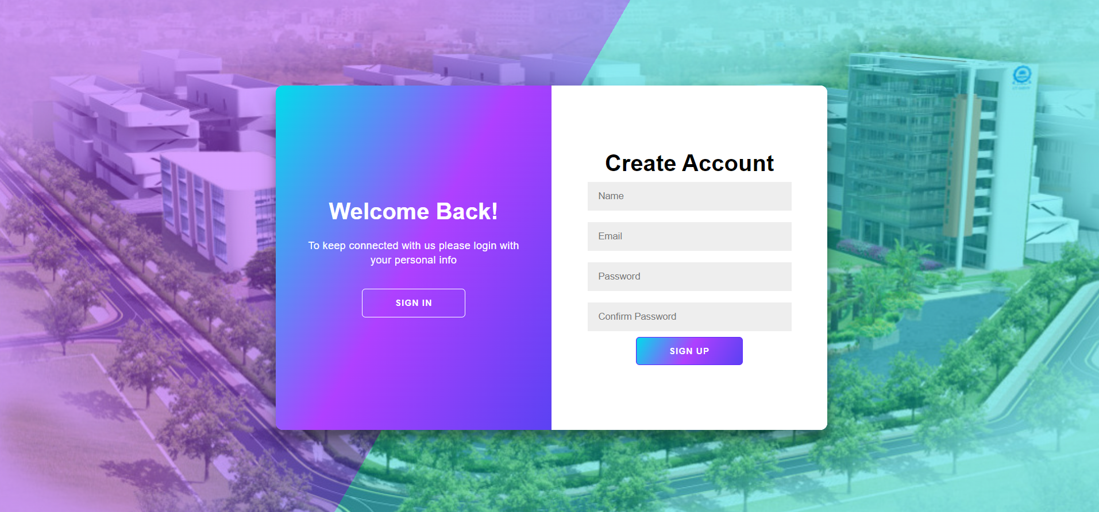
Create Account

Slide 15
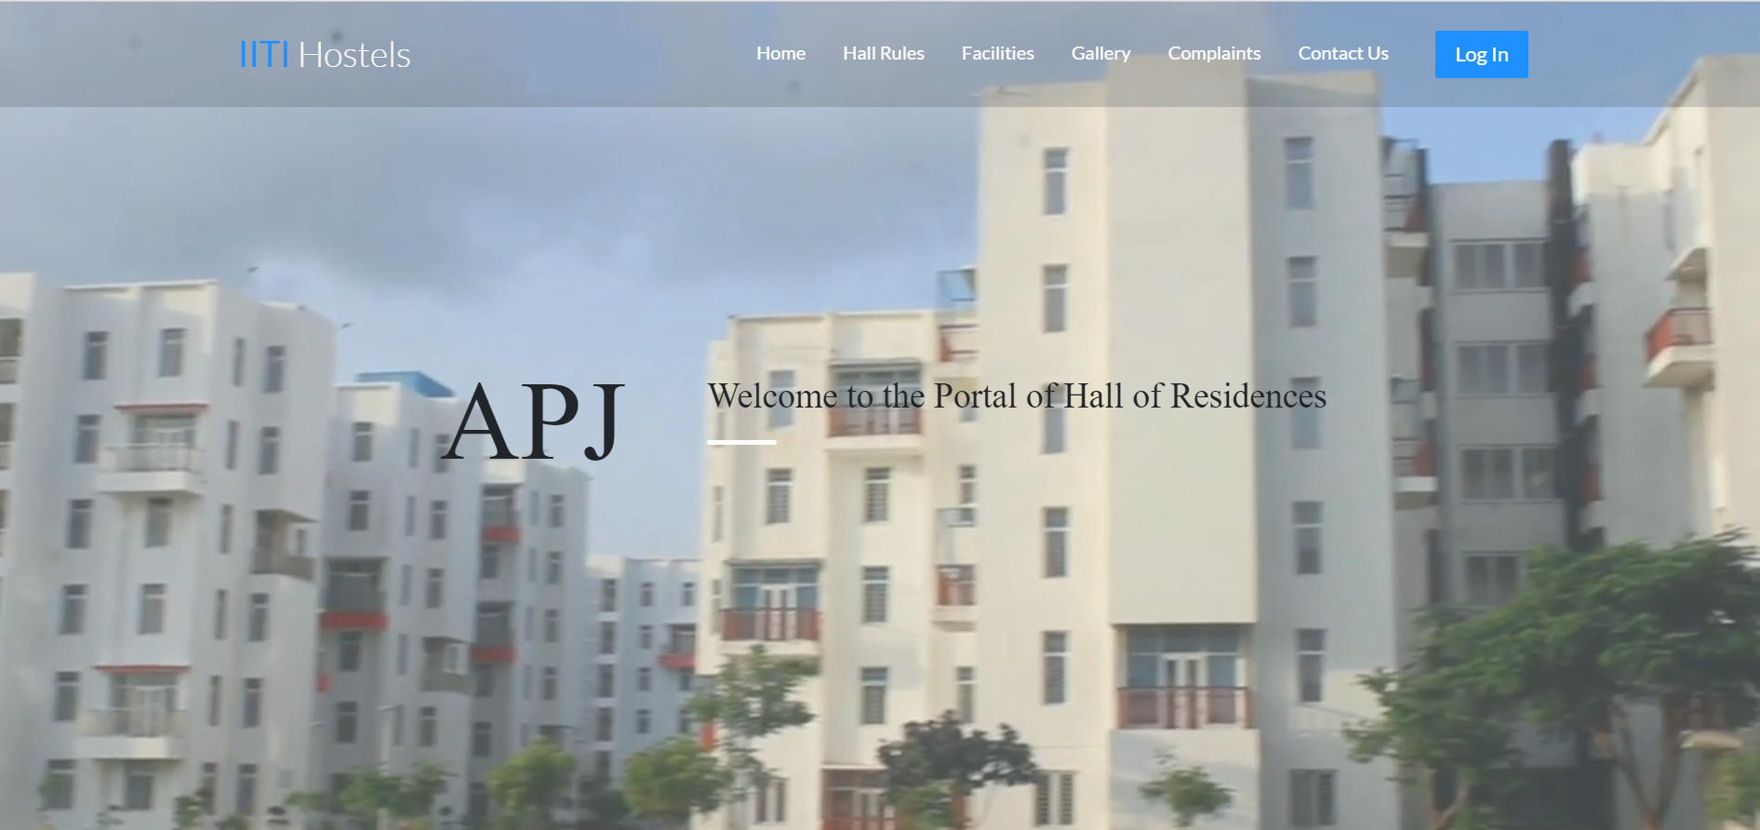
Hostel Pages with Videos

Slide 16
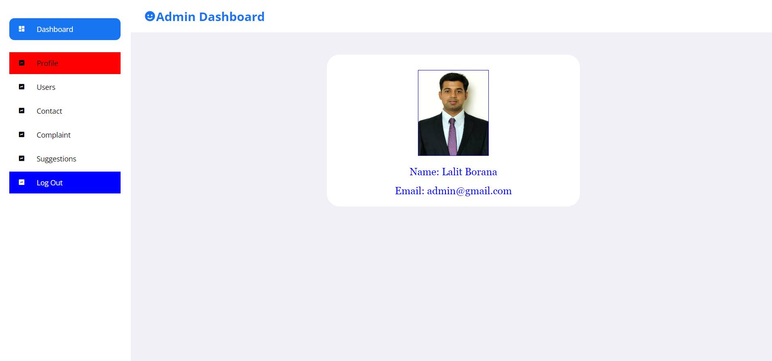
Admin Details/Dashboard

Slide 17
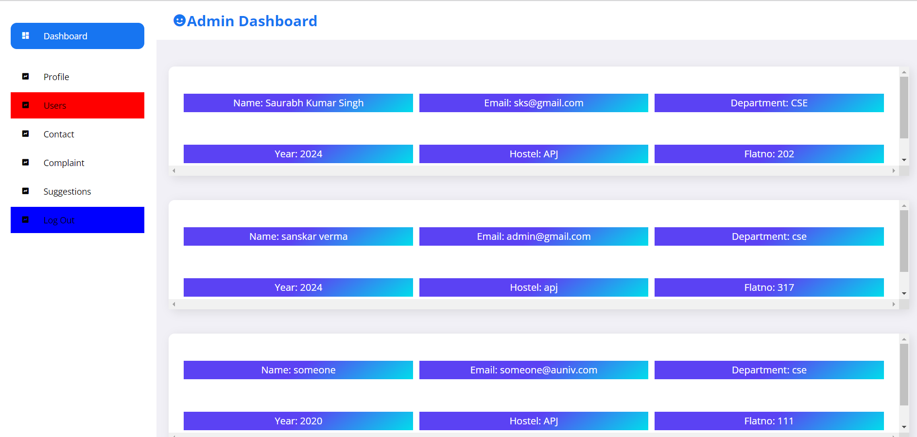
Students View

Slide 18
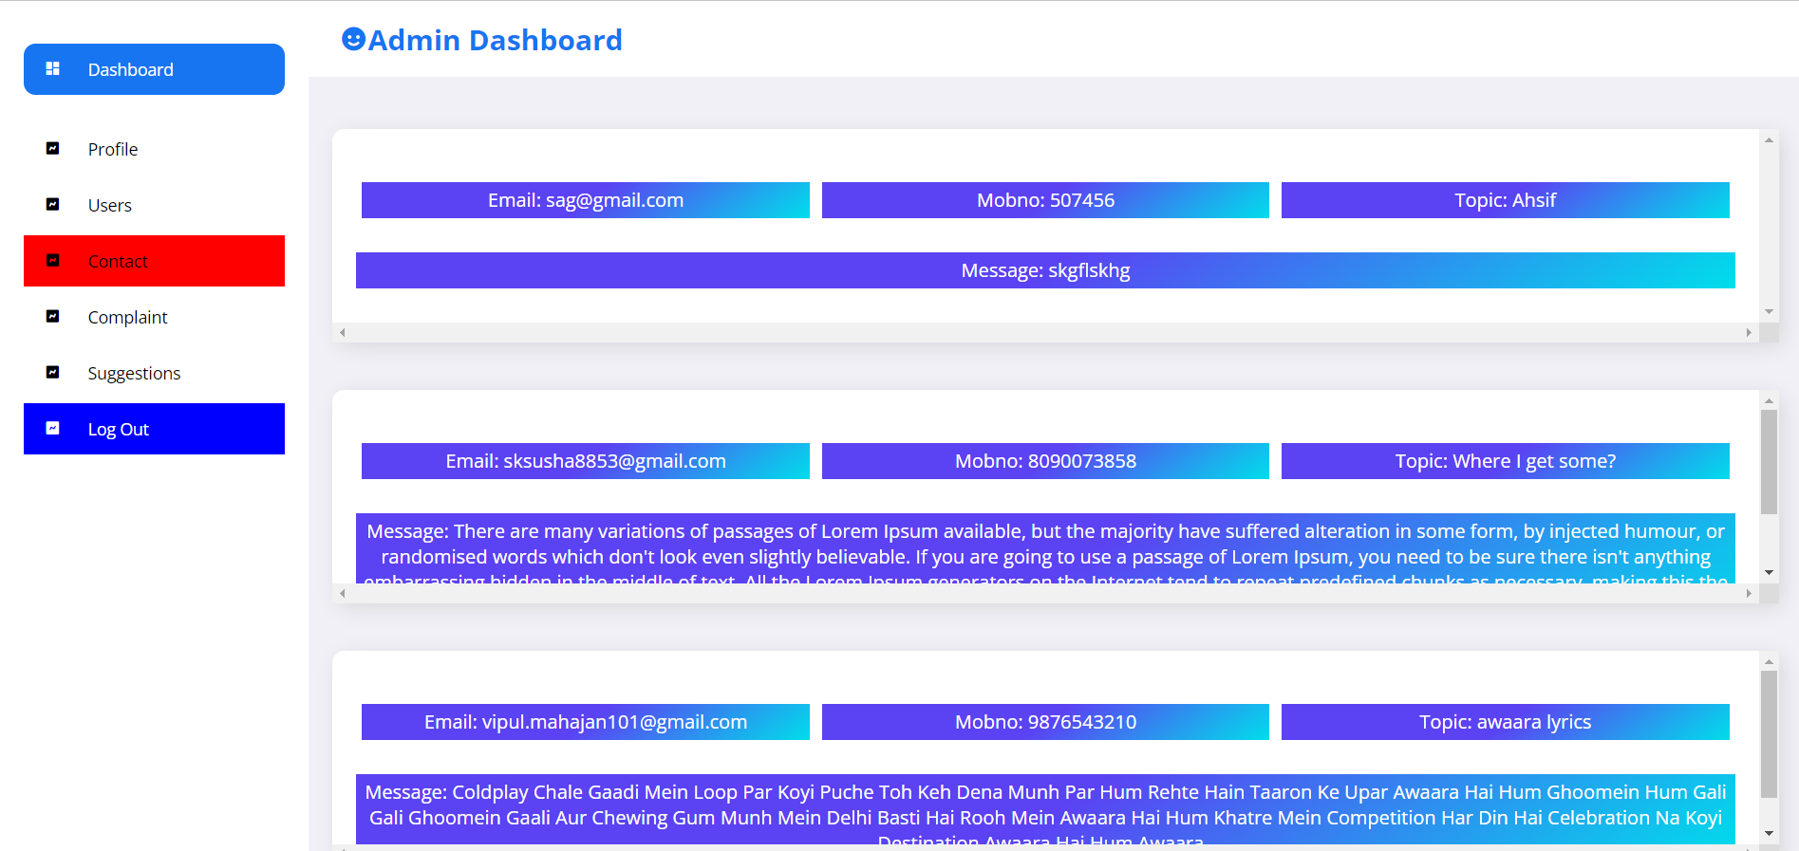
Contacts

Slide 19
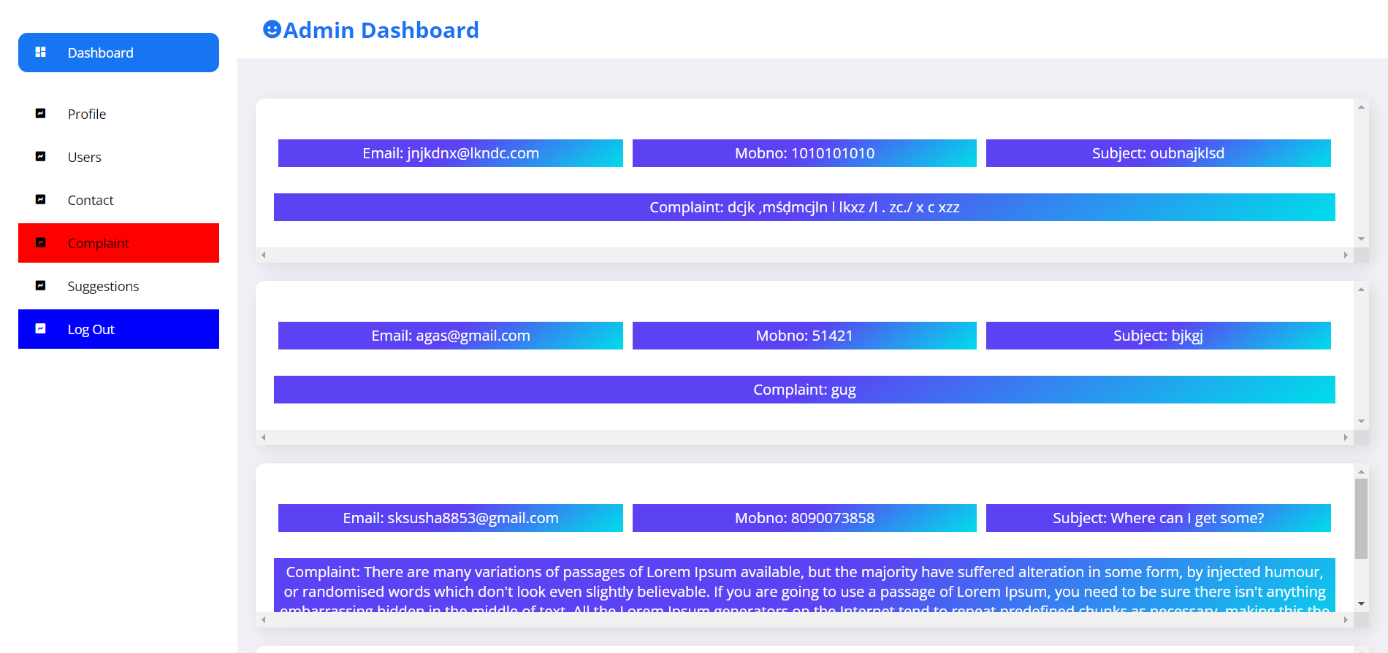
Complaints

Slide 20
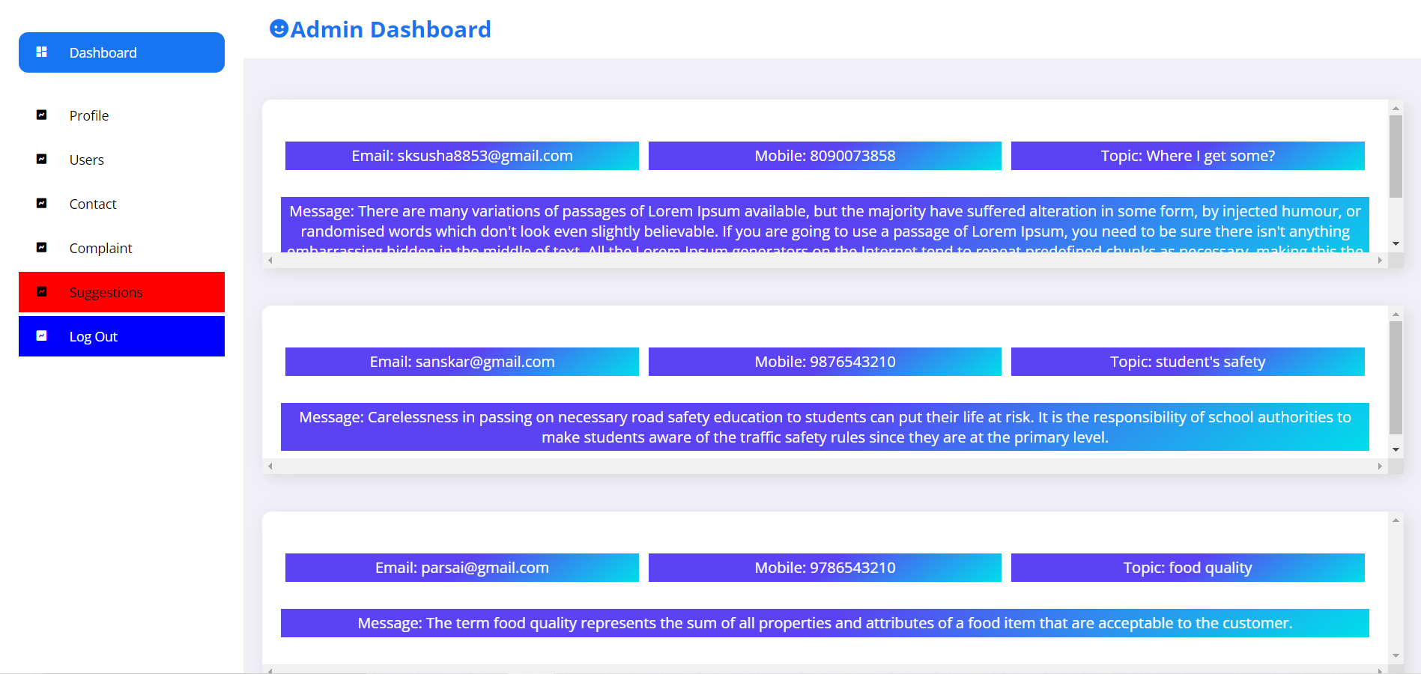
Suggestions

Slide 21
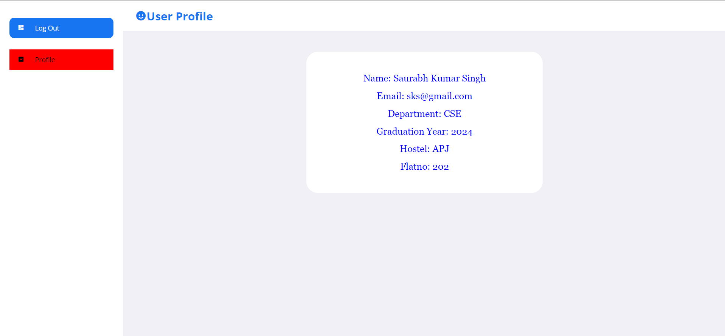
Student Detail View

Slide 22
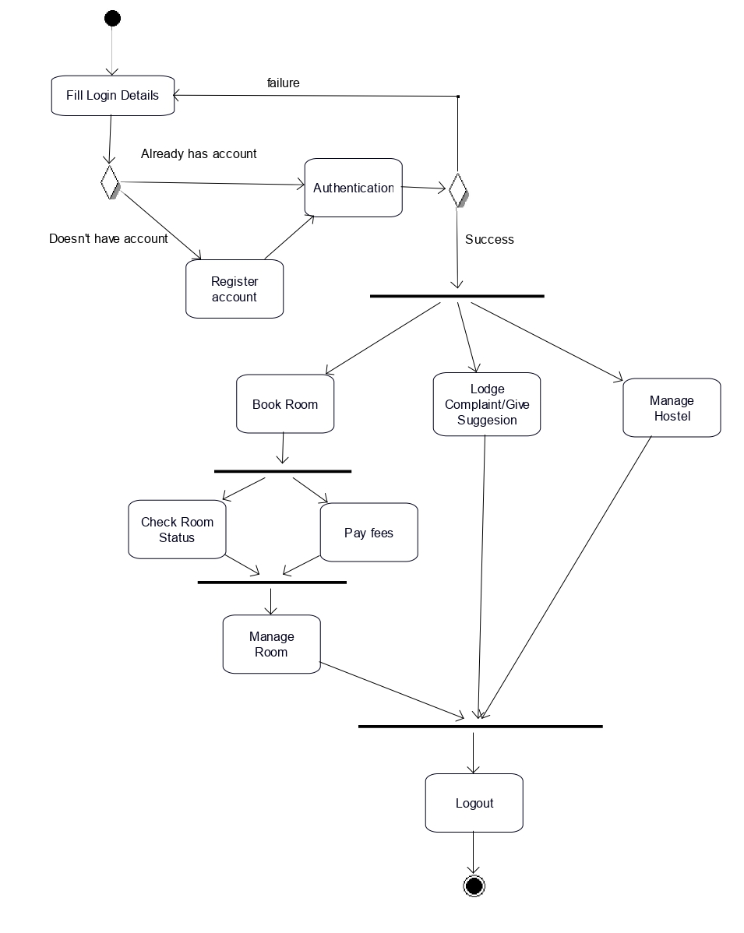
Activity Diagram

Slide 23
Project timeline
1
2
3
4
5
6
Planning
Interface
Creating Database
Application development
Adding Extra Features
Making everything run together
Planning out things and skills needed and the Activity Diagram
Creating Webpage use HTML and CSS
Creating a Database with its tables and attributes
Coding out the app which runs to add entries and commit all the other needed commands
Adding Inventory Management and Automatic Patient ADD/Update
Connecting and pre populating the database and making sure that everything runs properly without error

Slide 24
Points to Discuss
What have you learnt and implemented till now?
Learnt :- we had to learn Node Javascript and hosting a Heroku server.
Implemented :- As mentioned in the Software Requirements Specification (SRS) we made navigation panel, dashboard and feature to add and remove entities. Alongside hosting the pages which use Node and EJS and connect it to a database.
What is your Roadmap
Even if our project is complete and functional we think of continuing adding more features and testing them to gain more skill and experience.
Tools/Languages we used :- HTML, CSS, Node.js, EJS, MongoDB.
Outline :- Hostel Management System
Usability of project/examples
Hostels
Can be changed a bit to implement in other residential and hospitability systems
Some features like gallery, complaint and suggestion management system can be used any other platforms

Slide 25
5. Contribution of Members
200001053 Nilay Ganvit
Documentation of the project
Designing the Structure and coding extra features of the project and making UML Diagrams
Planning the Timeline and Roadmap along with creation of slides and presentation
200001068 Rishi Parsai
HTML, CSS and all the Designing the Frontend and UI of the webpage
Making the Structure more easily usable and customer friendly
Ensuring that functionality is compatible with Design
200001069 Sanskar Verma
Making Templates of Hostel Pages,admin dashboard and Index page.
Helping in making UML diagrams.
Finding and managing proper resources and materials.
200001071 Saurabh Kumar Singh
Debugging and Removing Errors from the code
Maintaining Integrity of the Database and making the structure of the whole project
Hosting and Running the project while ensuring that all works together
200001080 Vipul Mahajan
Login, Logout mechanisms including storing and management of database.
Profile information storage and Editing
Setting up the Backend and Database ready for use

Slide 26

Thank you!
200001053 Nilay Jayantibhai Ganvit
200001068 Rishi Parsai
200001069 Sanskar Verma
200001071 Saurabh Kumar Singh
200001080 Vipul Mahajan

